Slide 1

Sprint Review 2
Thursday, 1st October

Slide 2








Hello Again 👋
Jamie

Slide 3
Quick Outcomes 🙌
Clearly defined MVP
Overall UI starting to take shape
Backend libraries delivering usable data
Decided on working product architecture
Bonded as a team
Jamie

Slide 4
Frontend 👩‍💻
Developed UI prototype with colour
Defined the components needed to display data
Decided app will be built in React using Material for styling and layout, with additional CSS where appropriate
Started implementing grid layout for app
Gained a greater understanding of props, state and event handling and where they fit into our product functionality
Ellie

Slide 5
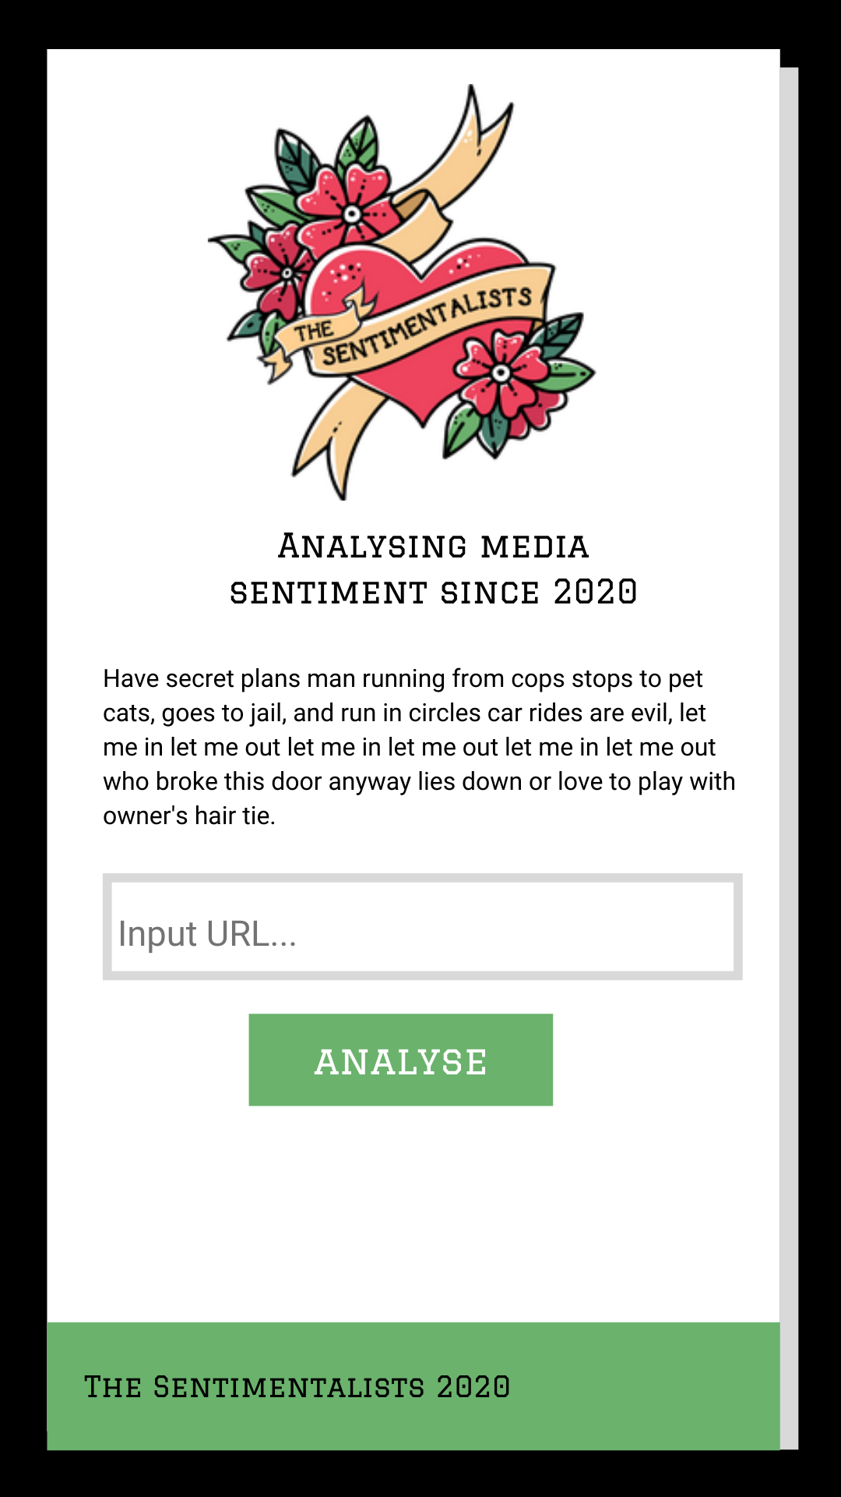
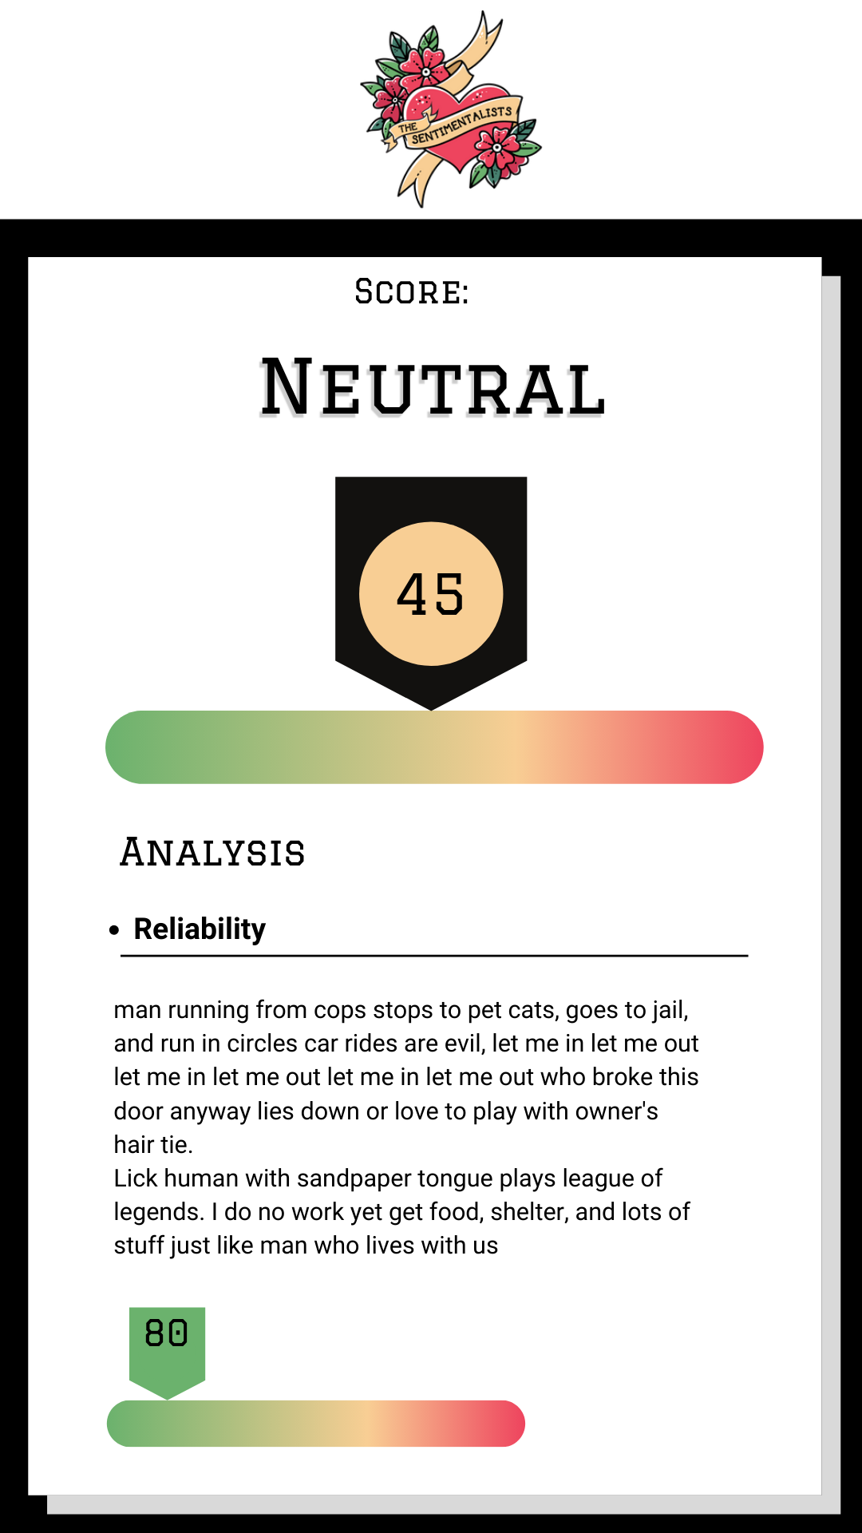
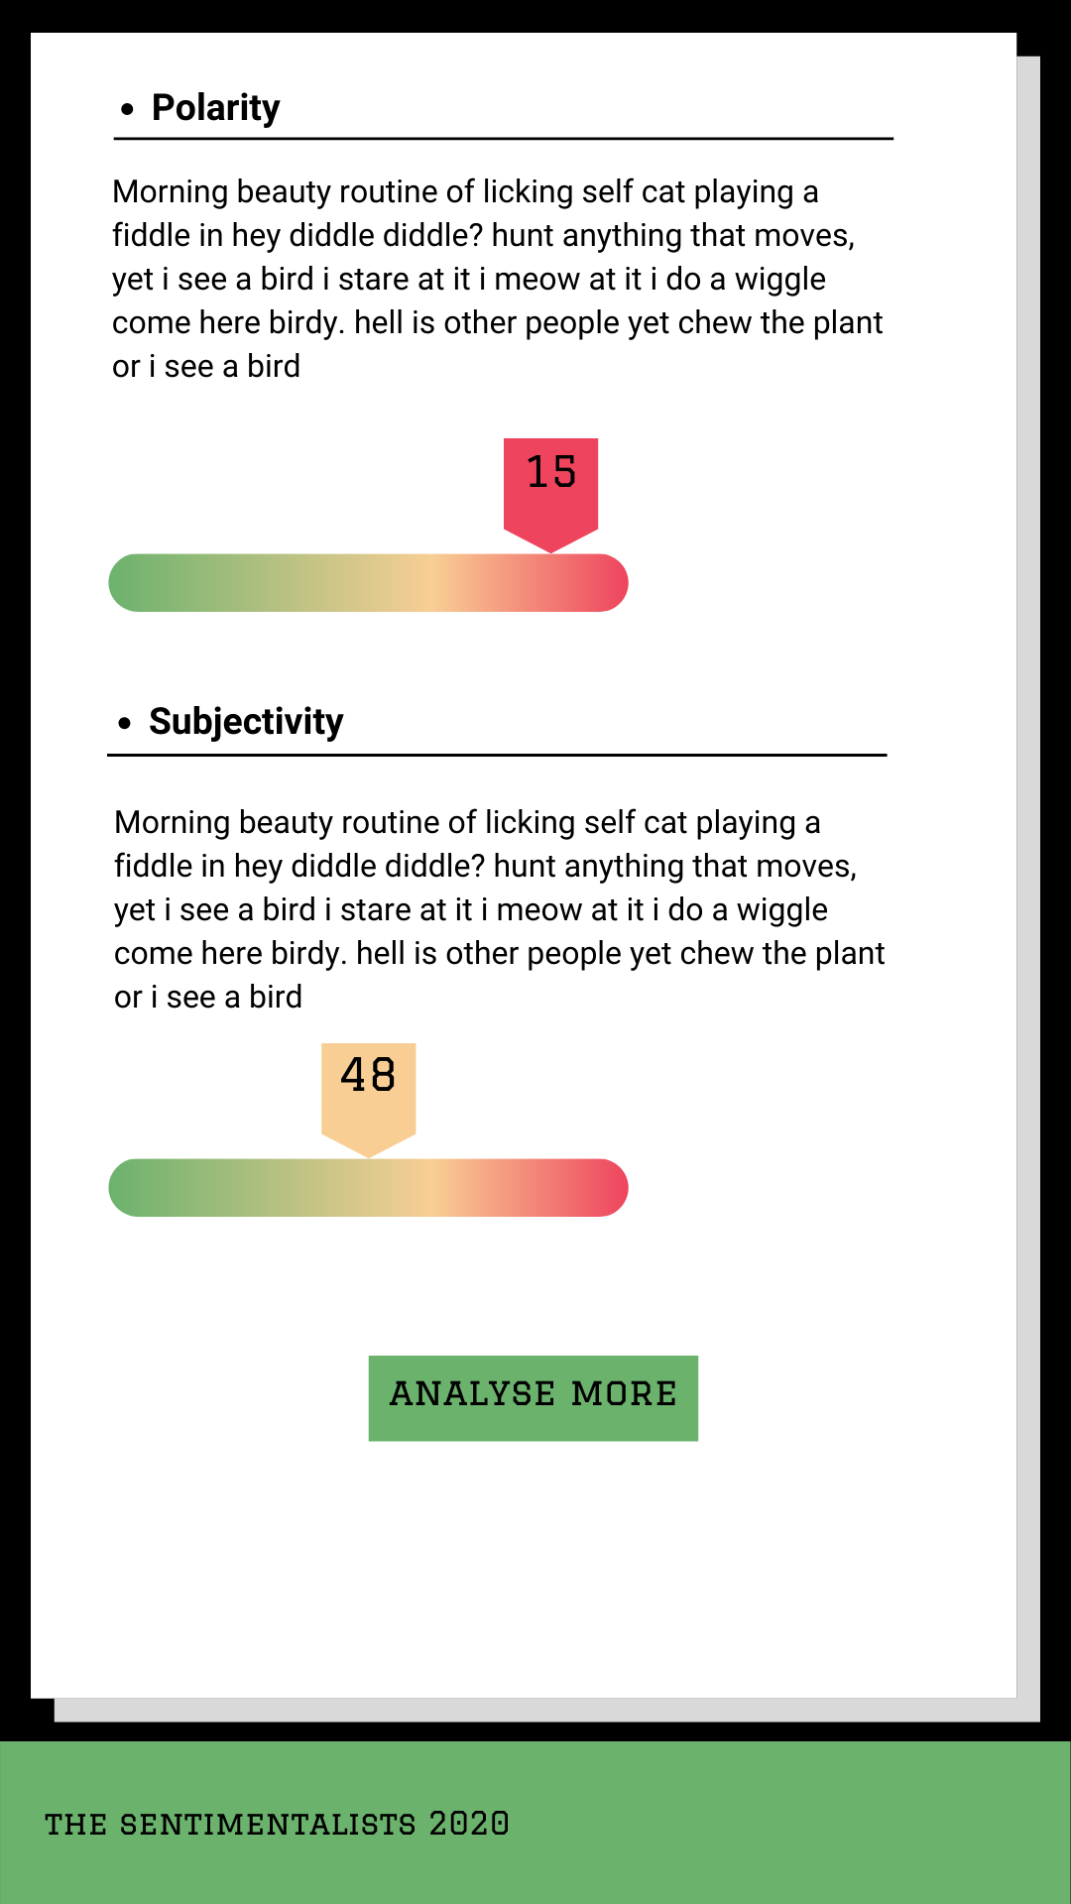
User Interface - Mobile
Ellie

Slide 6
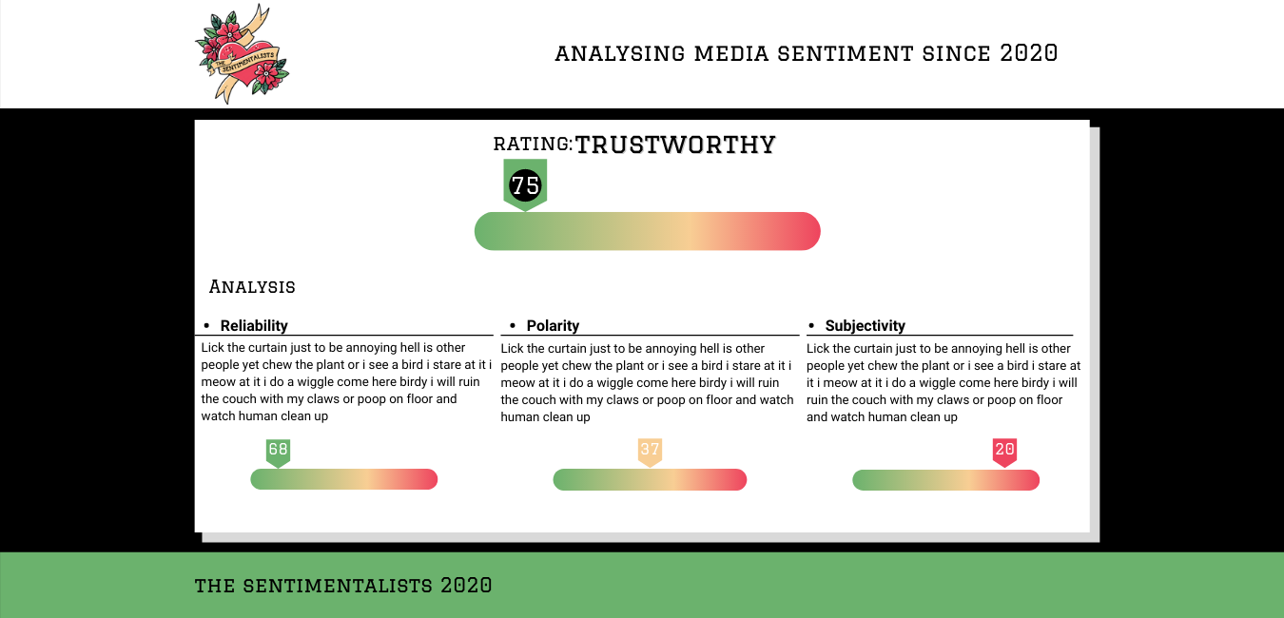
User Interface - Large Screens
Ellie

Slide 7
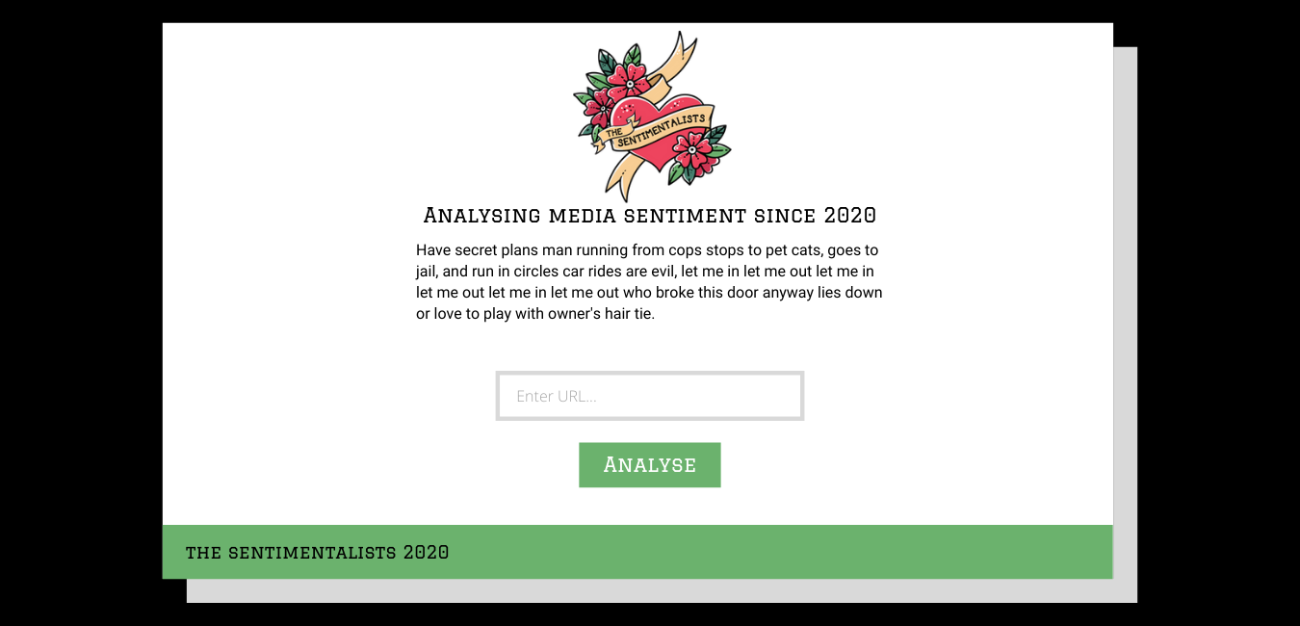
User Interface - Large Screens
Ellie

Slide 8





Backend ⚙️
Input for modules will be an URL (no free text / document upload at this stage)
Defined Python as backend programming language
Tools and Frameworks:
Visual Studio Code;
Visual Studio Live Share (collaboration);
Jupyter Notebook;
PyTest (testing);
GitHub (repositories and version control);
GitHub Project Board (track project tasks);
Ana

Slide 9
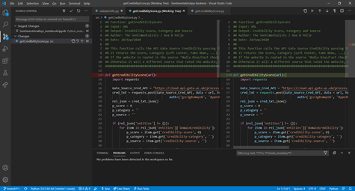
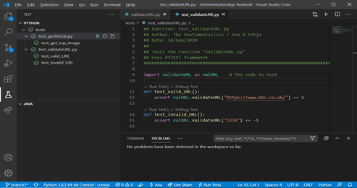
Backend ⚙️
VsCode X Pytest integration
VsCode X GitHub integration
Ana

Slide 10
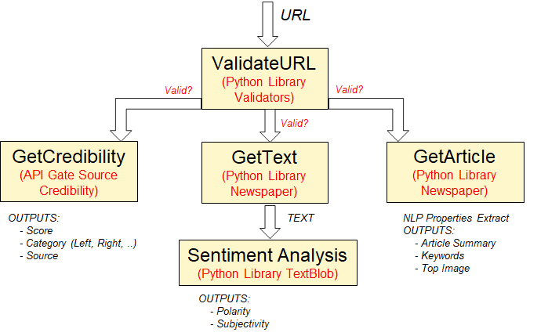
Backend ⚙️
Python modules:
Ana

Slide 11
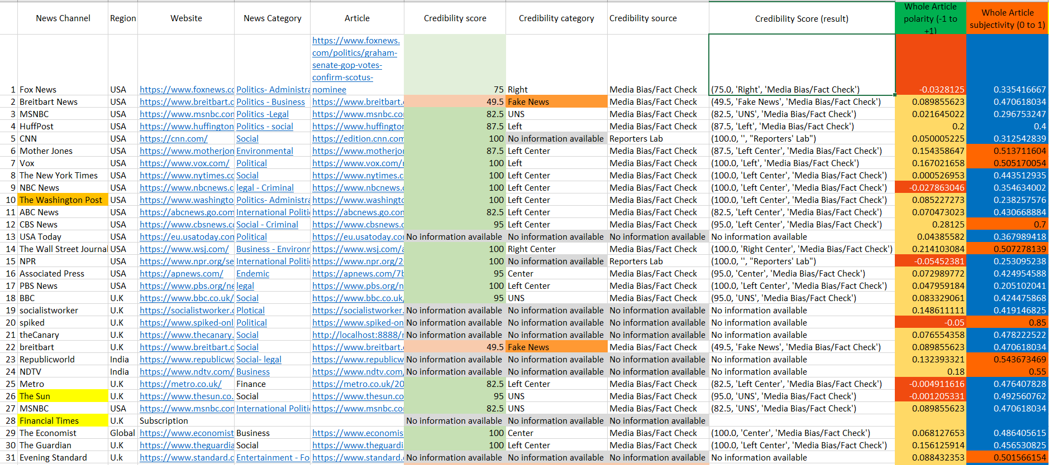

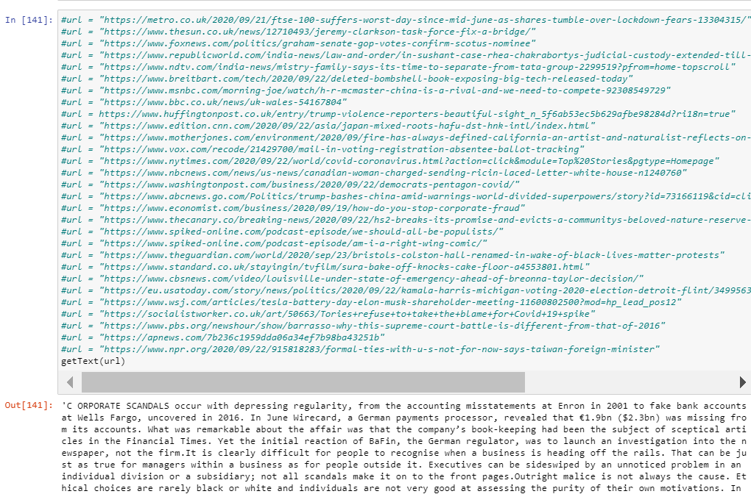
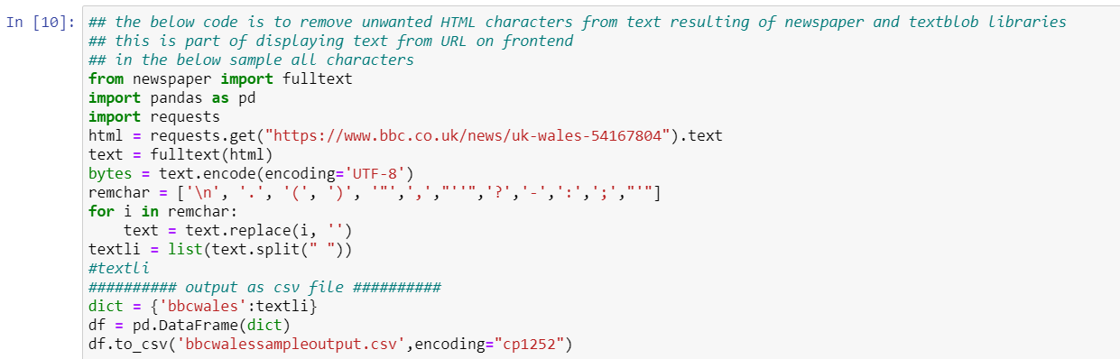

Backend
Tests, tests, tests!
Tested Sentiment Analysis function - noted Polarity, Sensitivity results from 30 News articles with varying sources, subjects
Tested Credibility Score function - credibility scores, category and source results noted
Discussed results and observations with team to draw further actions (validate URL, error causing article, follow-up with Gate Cloud solution)
Created Python code removing unwanted characters from text to display
Jyothsna

Slide 12
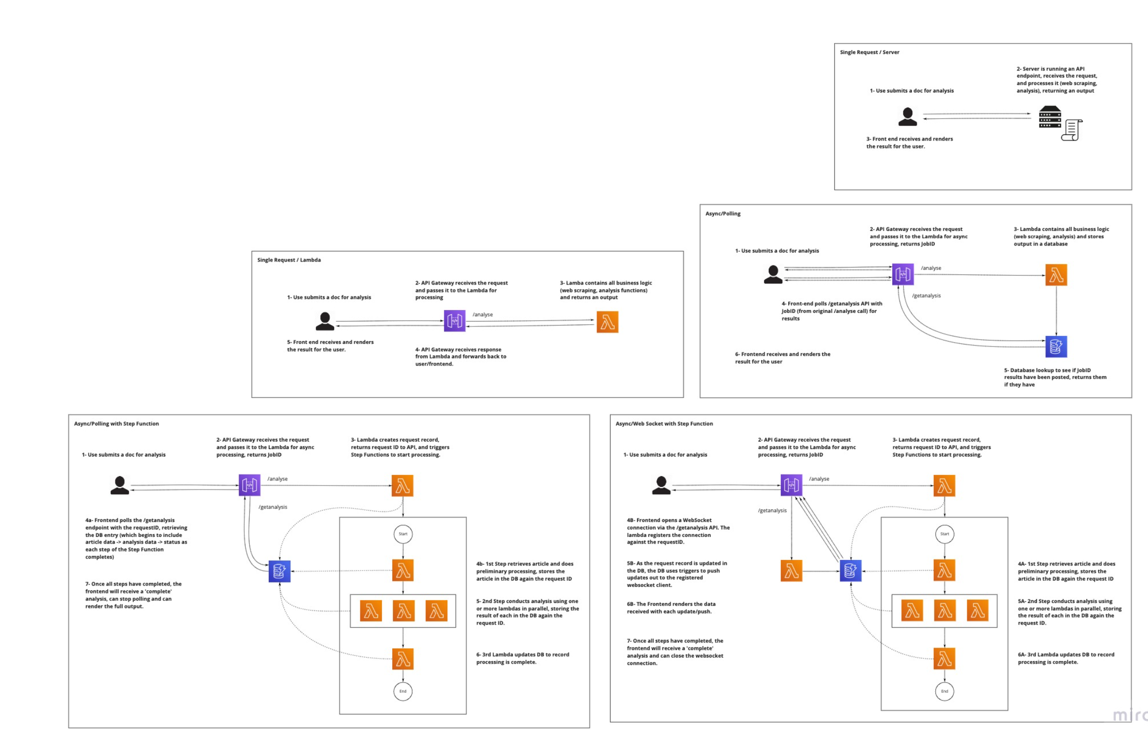
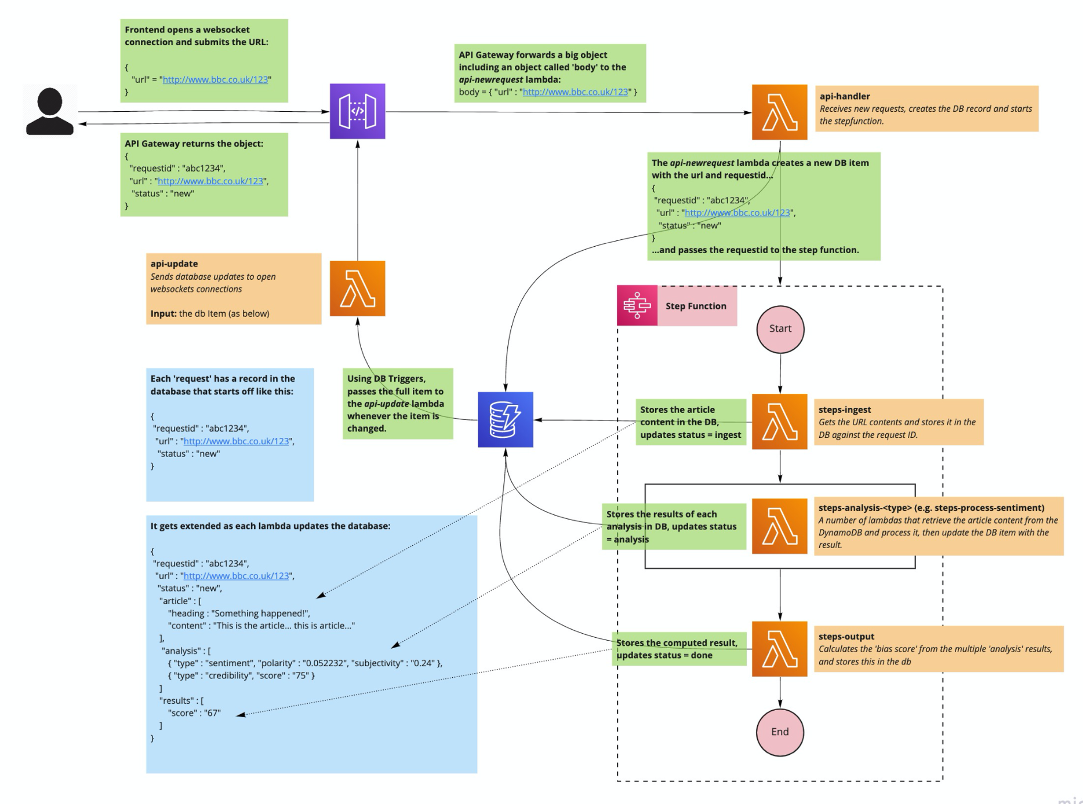
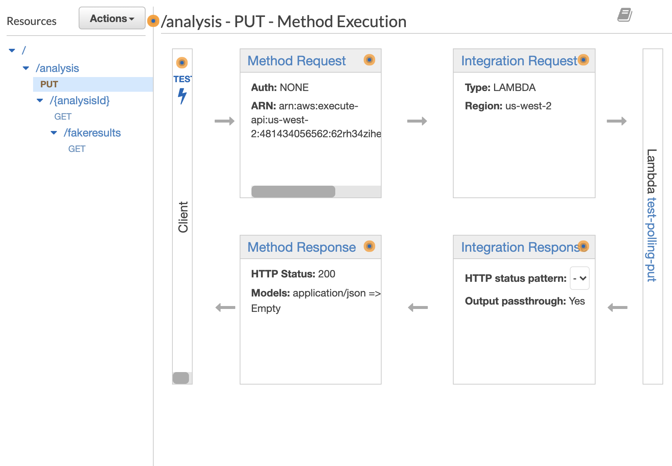


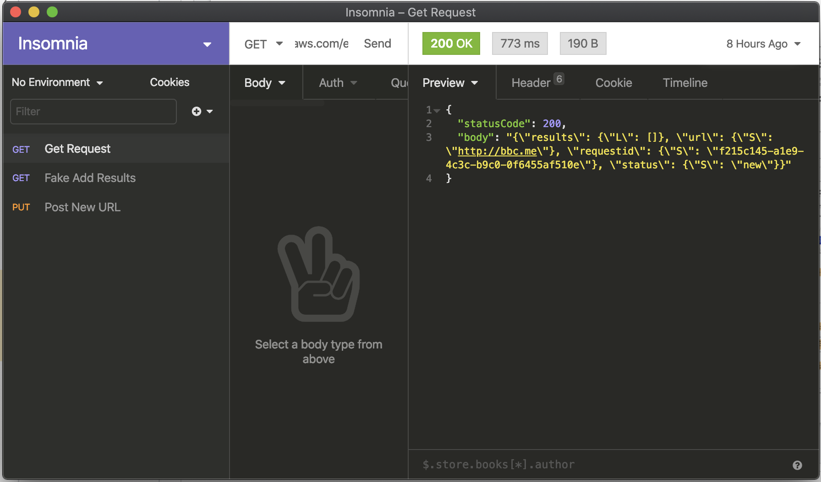



Infrastructure 🔌
Explored different architecture patterns
Reviewed pros and cons of each for our needs
Mocked up a couple of the designs in AWS
Implementing the final architecture using AWS API Gateway, Lambdas (Python), DynamoDB (NoSQL) and Step Functions, deployed with Terraform
Jamie

Slide 13











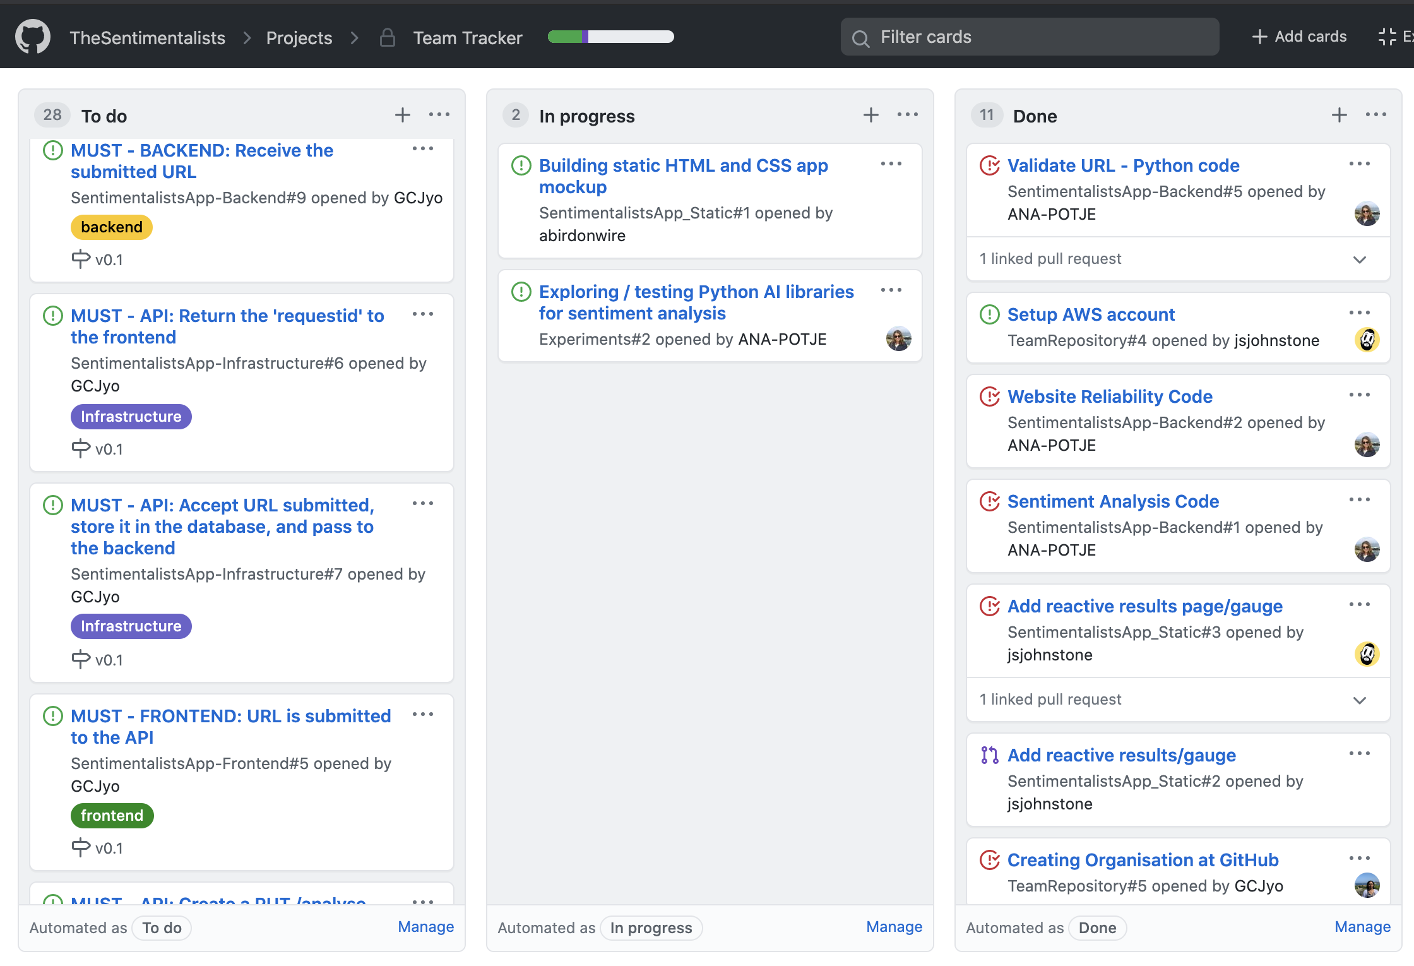
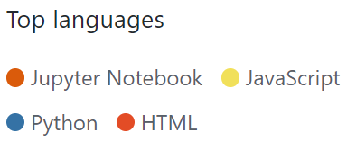


Team Practices
Daily standups, formal retro meetings, test driven development, Pair programming as we move into V1.0
Github Team tracker to priorities tasks in each sprint
Collaboration: Reviewed various ways to display results at frontend and agreed one particular method to present the information
Jyothsna

Slide 14
A First Draft 🎯
Agreed our first milestone/set of features, getting structure in place and our first data flowing:
Version 0.1:
A simple front-end allowing the user to enter and submit a URL and view analysis results (just ‘website credibility’ to get us started).
An API layer providing two endpoints: one to submit a URL/the request, and another to poll for results
A backend that retrieves the credibility score for the given URL and stores results against the request
Frontend 👩‍💻
API 🔌
Backend ⚙️
Ana

Slide 15
The First Major Milestone 🌟
Extending functionalities to create a useful tool
Version 1.0
Retrieve and store the article content
Add additional analysis, such as polarity, subjectivity
Calculate a cumulative ‘bias score’
Jyothsna

Slide 16
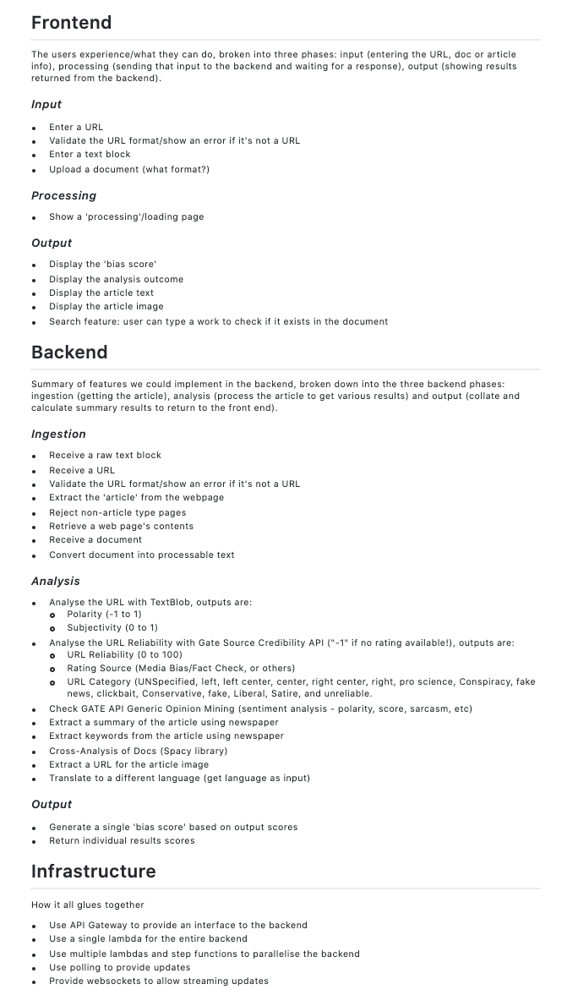
The Future Goals 🚀
Many other features explored which we will consider for future iterations
Version 1.5+
WebSockets
Analysis
API
Political
Processing/Loading Animation
Better Error Handling
Summary
Display Article Text
UI
URL Format Validation
Display Article Image
Ellie

Slide 17
Next Sprint Goals 🏆
Get through the v0.1 tickets
Jamie

Slide 18
Questions?

